Slide 1



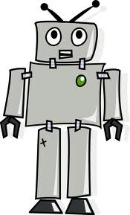

Cornell Chronicle: A robot learns how to tidy up after you
Presentation by Nathan Tung
CS35 Lab 1

Slide 2
Background Information
Cornell’s Personal Robotics Lab created a robot that can clean up after people
The robot basically:
1. Evaluates the room
2. Identifies the objects
3. Puts each object where [it thinks] it belongs
Robots in the past could only place single objects on flat surfaces

Slide 3
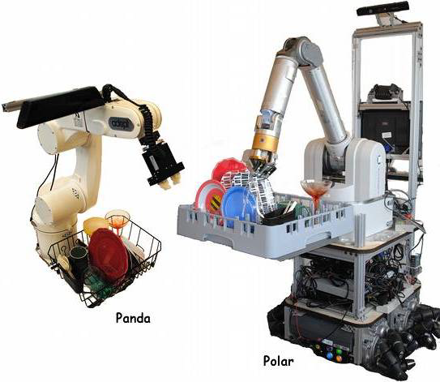
Cornell’s Robots
PANDA
PersonAI Non-Deterministic Arm
POLAR
PersOnaL Assistant Robot

Slide 4
Latest Algorithm
Considers nature of the object
Determines where to put the object
Learns from previous experiences
Example: it doesn’t put a shoe in refrigerator
Also, it has to distinguish between flat surfaces like the floor and a table

Slide 5
Robot Performance
98% successful in identifying and placing objects it had seen before
80% successful for placing new objects
Objects with ambiguous shapes are hardest to place
Clothes, shoes, etc.

Slide 6
Evaluating and Identifying
Microsoft Kinect 3-D camera scans room
Robot’s computer breaks image up into chunks based on different colors/shapes
Can be trained to store different objects and their common characteristics
Groups of blocks converted to objects
Based on closest-matching blocks in database

Slide 7
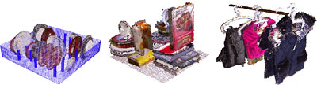
Determining Placement
Computer breaks image up into blocks of potential, stable target spaces
Can be fed images as examples of either good or bad placement sites for future reference
Chooses placement space with best stability and fit

Slide 8
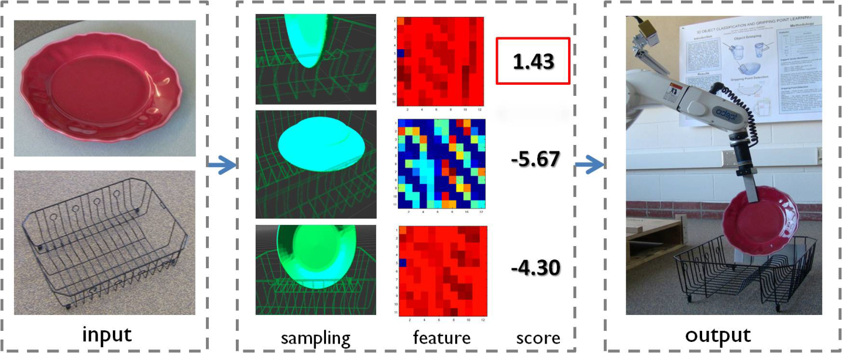
Moving the Object
Simulates a graphic of moving object to placement destination
Follows those movements robotically

Slide 9
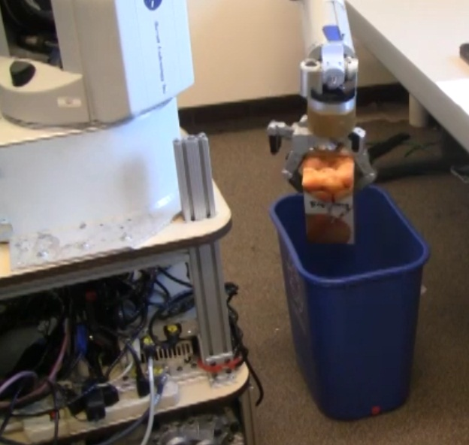
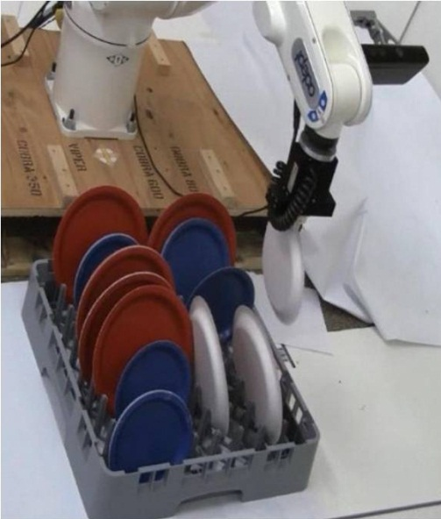
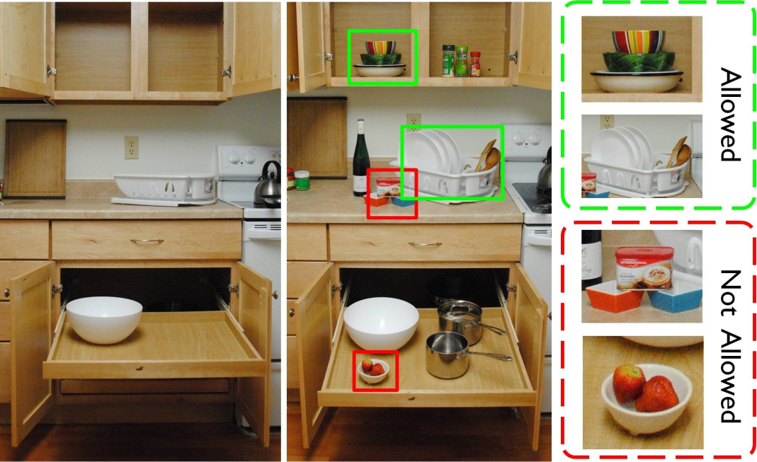
Throwing away trash.
Stacking dishes.
My Opinion:
This is absolutely amazing…

Slide 10
Reliability?
Robot can still break fragile objects
Robot only screenshots parts of the object, so it relies heavily on shape
Are there any possible improvements?
Higher-resolution camera to better identify
Pre-program robot with 3D models of objects
Use touch feedback to verify object is stable

Slide 11
Sources
Steele, Bill. “A robot learns how to tidy up after you.” Cornell Chronicle 21 May 2012. 1 June 2012. <http://www.news.cornell.edu/stories/May12/PlacingNewObjects.html>.
Jiang, Saxena et al. Learning to Place New Objects in a Scene. Cornell University. 2012. Web. 1 June 2012.

